Slide 1
18ECO134T – Sensors and Transducers
Unit III : Session 2 : SLO 1
SRM Institute of Science and Technology
Notes:
Pl use Font Family : Arial Narrow
To enhance the teacher presentations and the overall comprehension of students, it allows to present their lessons in a more dynamic and effective way. Set a Learning Objective:
1. Write an Outline for Key Ideas
2. Give the Presentation About Education a "Why"
3. Share Techniques and Tips for the Topic
4. Teach With Visualizations
5. Use Animations Carefully

Slide 2
Acoustics temperature sensors

Slide 3
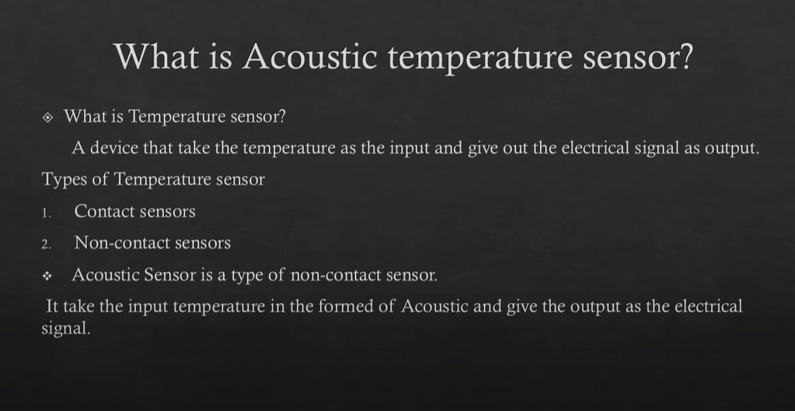

Slide 4
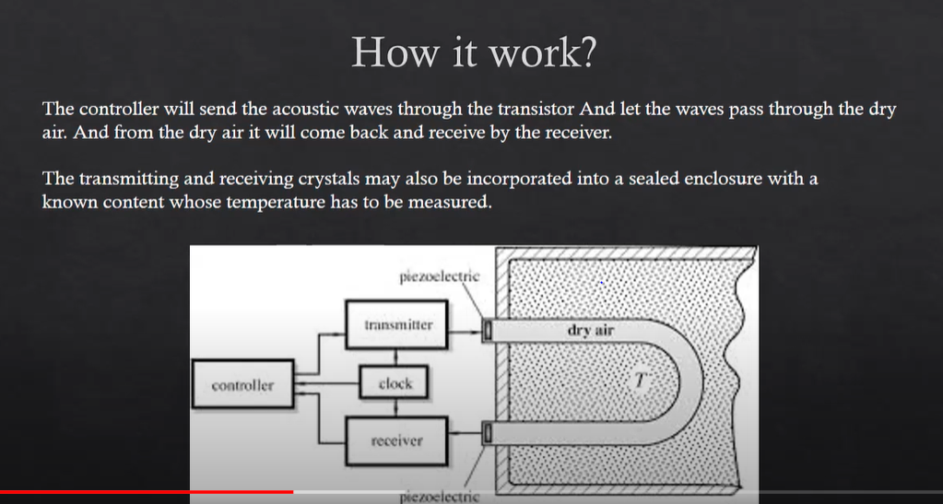

Slide 5
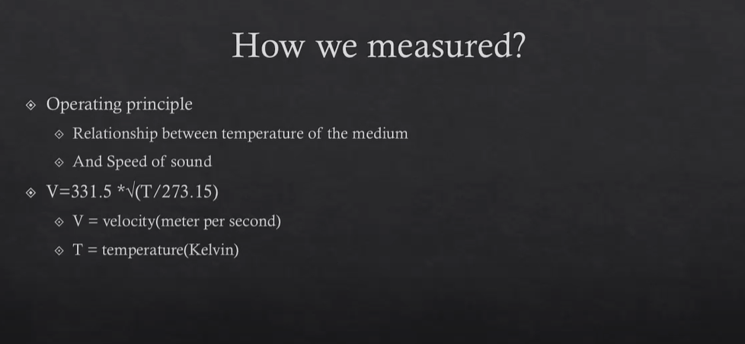

Slide 6
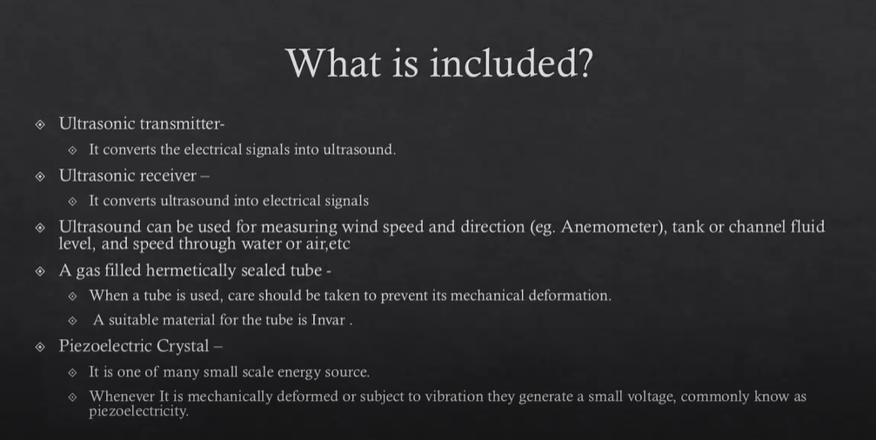

Slide 7


Slide 8
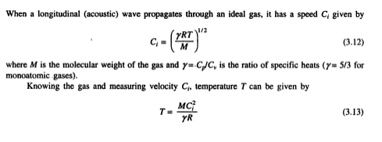
ACOUSTIC TEMPERATURE SENSOR
The realization of this technique is made in acoustic helium interferometer whose working is explained through Fig. 3.6.
A quartz crystal excited to its resonance frequency is used to transmit this wave through a gas (He) column to be faced by a piston. The wave is reflected at the piston surface to form a pattern as shown.

Slide 9
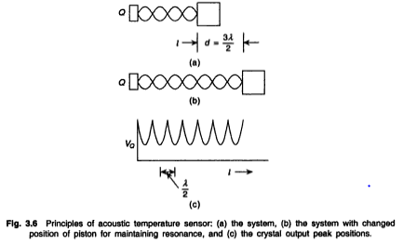
When the path length l has a multiple number of half-wavelengths and correspondingly the gas column is set to resonate at each such half-wavelength gap, with the piston moving away from the crystal at each resonant peak, the crystal gives out maximum energy and hence the voltage V_{Q} across the crystal defines peaks as shown in Fig. 3.6(c).
If the piston moves by a distance d to give n such peaks, d = nλ/2 from which C, is determined and thence temperature T. The piston movement must be accurately monitored to within, say 1 μm.

Slide 10
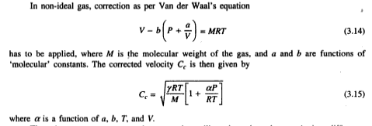
There is a nonresonant acoustic sensor that utilizes the pulse-echo transit time difference which changes with temperature. Figure 3.7 is a schematic representation of the sensory parts of the measurement system.
An ultrasonic pulse is transmitted through the sensor, a part of which is reflected at the entrance (a discontinuity) and a part at the end, as shown.
The reflected pulses are received by the transreceiver coil at an interval of called the transit time.

Slide 11
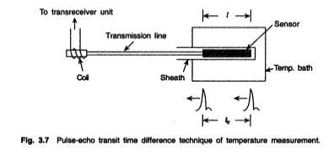
The pulse that travels the entire length of the sensor is delayed more/less depending on the change in the sensor temperature.
This temperature dependence is a function of the path length l, sensor material, temperature range, and vibration mode even if the first echo is considered.
The different materials are listed in Table 3.4 with their temperature ranges.

Slide 12
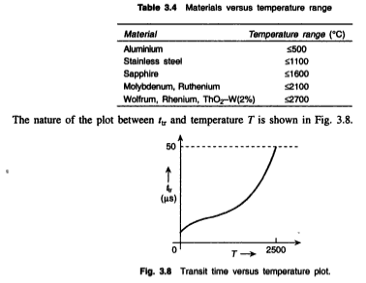

Slide 13
The sensor may be made in the form of a thin wire with restrictions or constrictions at intervals of space where the reflections would occur.
The wire diameter varies from 0.03-3 mm and spacing between restrictions varies from 5-10 mm in a sensor length of 15-50 mm, and a number of echos can then be produced.
There should not be any inhomogeneity in the material faced by the wave except for the restrictions.

